Slide 1

Uber
Data Visualization & Analysis
By- Bhavesh Khanchandani
© All rights reserved by Fireblaze Technologies Pvt. Ltd.

Slide 2
Problem Statement
To find possible insights from given Uber dataset using data visualization.
Uber is an app-based transportation network and taxi company.
In its Airport rides in a particular city, many of its users face the problem of cancellation by the driver on non-availability of cars.
These very issues impact the business of Uber and it loses out on its revenue.
Our core problem resides in the activity of the number of the pickups from the airport which are not a par with the number of drops.
© All rights reserved by Fireblaze Technologies Pvt. Ltd.

Slide 3
Proposed Solution
To find possible insights from given Uber dataset using data visualization using python libraries like Seaborn and Matplotlib
Push notification when the user lands.
Pre-book after Drop off.
Uber WiFi spots.
Algorithmic Preference to Vacant Cab Drivers
Reduction on Uber commission on airport pickup rides.
© All rights reserved by Fireblaze Technologies Pvt. Ltd.

Slide 4
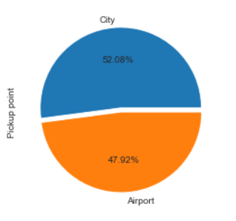
Descriptive Analysis
Pickup points Airport vs City
© All rights reserved by Fireblaze Technologies Pvt. Ltd.

Slide 5
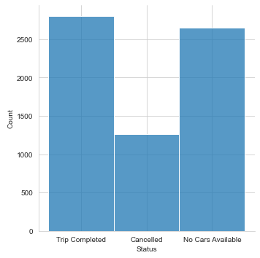
Descriptive Analysis
Number of people who completed a trip
© All rights reserved by Fireblaze Technologies Pvt. Ltd.

Slide 6
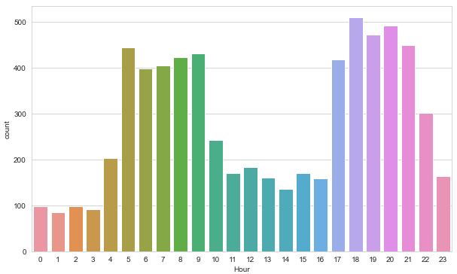
Descriptive Analysis
Most busiest time of the day
© All rights reserved by Fireblaze Technologies Pvt. Ltd.

Slide 7
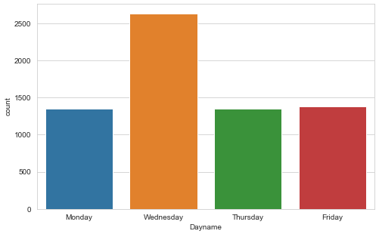
Descriptive Analysis
Most busiest day of the Week
© All rights reserved by Fireblaze Technologies Pvt. Ltd.

Slide 8
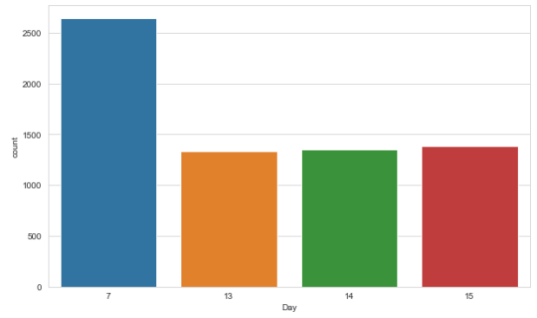
Descriptive Analysis
Most rides on which day of the month
© All rights reserved by Fireblaze Technologies Pvt. Ltd.

Slide 9
Advantages
Easily available
Professional Service
Safe and Flexible rides
© All rights reserved by Fireblaze Technologies Pvt. Ltd.

Slide 10
Disadvantages
Surge Pricing
Higher pricing compared to competitors
© All rights reserved by Fireblaze Technologies Pvt. Ltd.

Slide 11
Conclusion
By Visualizing the data we get to know about some useful insights like:
Less than 50% trips are completed and in almost 40% cases cars are not available in customer's area of pickup.
Trip count is highest on Wednesday.
Very less number of cars are available around Airport pickup location.
Highest number of trips are booked around 6 pm to 8 pm.
© All rights reserved by Fireblaze Technologies Pvt. Ltd.

Slide 12
Future Scope
Company should increase number of cars present around airport pickup location as customers are regularly checking for cars from airport.
Company should decrease fare around city pickup location as booking cancellation rate is high in this area.
Company should try to make available more cars on Wednesday in order to satisfy customer's needs.
© All rights reserved by Fireblaze Technologies Pvt. Ltd.

